Slide 1

Citi Bike Case Study
Ishita Agrawal
Kamaldeep Kaur
Calen McKinney
Aamir Sohail Mohammed
Maliha Nadeem, FNU
Kiran Subramani

Slide 2
Objective and Question
Objective:
Determine the optimal number of bikes to stock at each station at the start of each day to maximize the number of daily bike trips. Let’s predict the demand for Bikes on Sept. 06, 2018.
Questions:
1. How many trips occur between stations each day, categorized by morning and evening periods?
2. How many bikes need to be allocated to each station to meet the demand?
3. What are the peak hours of bike usage during the daytime and evening periods for each of the 5 chosen stations?
4. Are there any specific factors (e.g., temperature, precipitation, trip duration) that significantly affect demand?

Slide 3
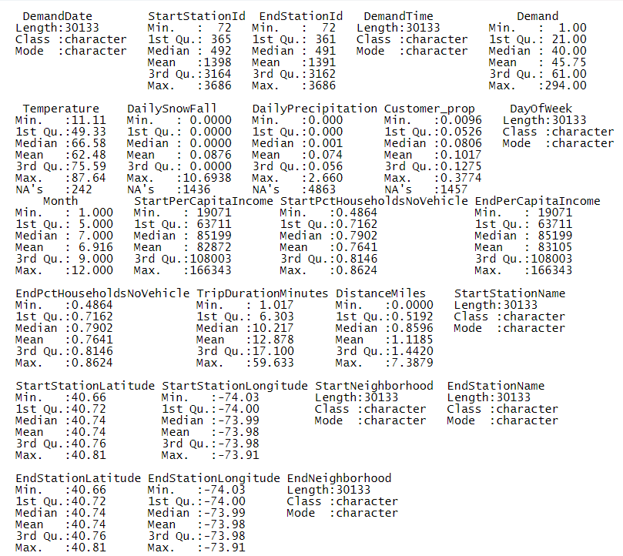
What did you find in the data?
What is not pictured?
31,414 total entries, with 25 total columns
Missing values!
Dealing with missing values
Some missing values were present in the data, so we imputed the mean for those columns, as well as converting DemandTime, StartStationId, & EndStationId into factors.
Highlighting “Demand”
Minimum = 1.00 / Maximum = 294.00

Slide 4
Descriptive Analysis
Compute descriptive statistics
Univariate: The mean of demand came out to be 45.36, while the standard deviation of demand came out to be 32.61.
Bivariate: The correlation between demand & temperature came out to be 0.02 which suggests a very weak but positive relationship between them. The covariance between demand and temperature of 10.40 indicates a positive relationship.

Slide 5
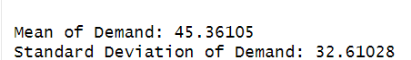
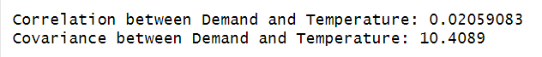
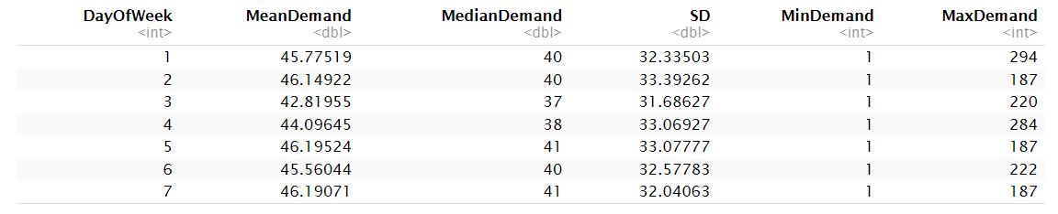
Evidence from Descriptive Analysis

Slide 6
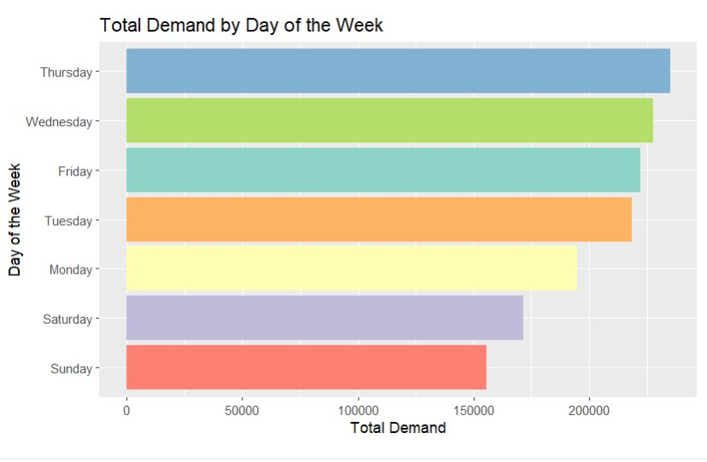
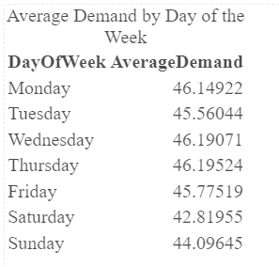
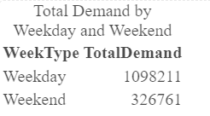
Visualizations using ggplot
Demand for bikes is higher on Thursday, Wednesday, and then Friday. But the demand is more on weekdays than on weekends.

Slide 7
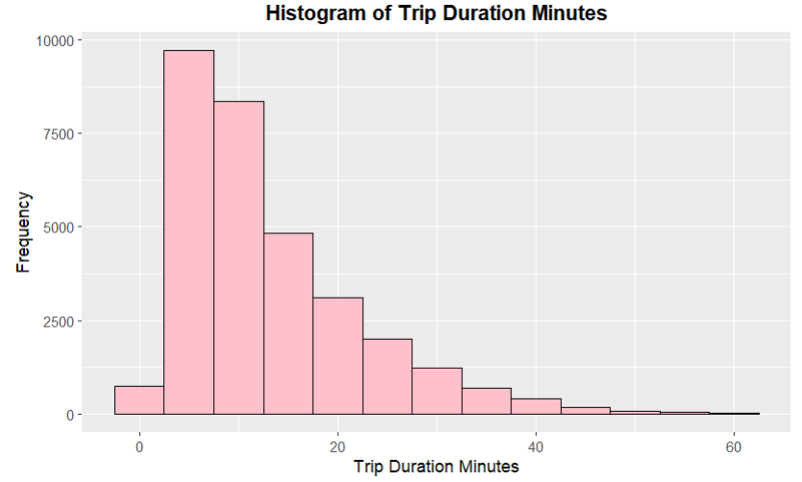
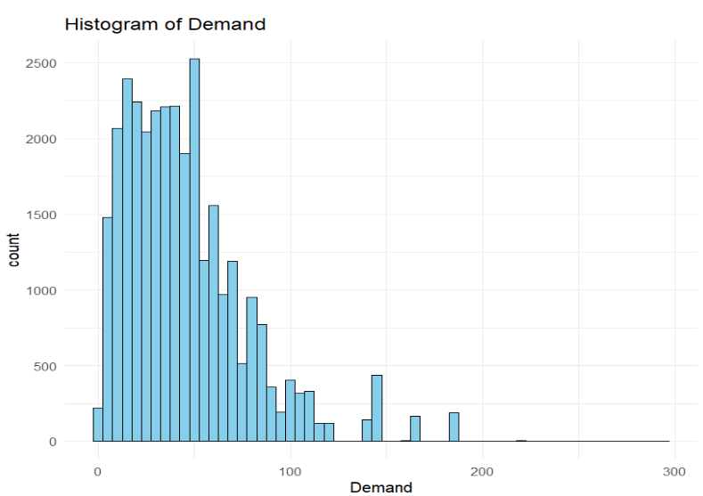
Visualizations using ggplot
The highest trip duration time is 5 minutes and then 10 minutes, so we can conclude that short trips are more frequent.
The majority of bike stations have a demand of 50 or so bikes, which is greater than the mean demand.

Slide 8
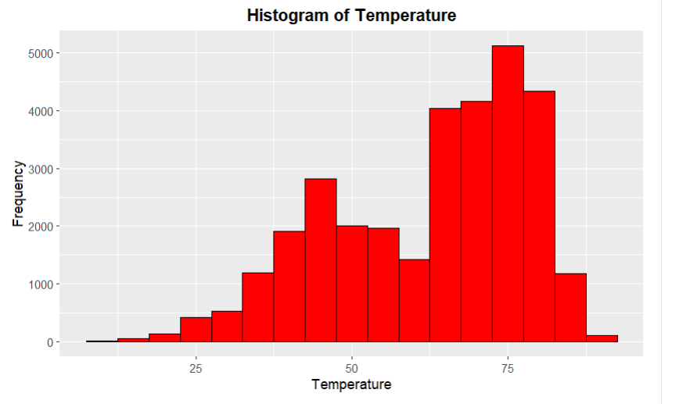
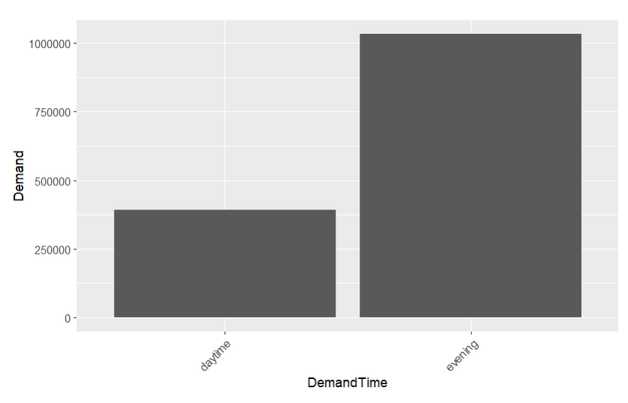
Visualizations using ggplot
Looking at this temperature distribution, the demands are high when temperature is at 75 degrees.
There is a higher demand for bikes in the evening, than in the daytime.

Slide 9
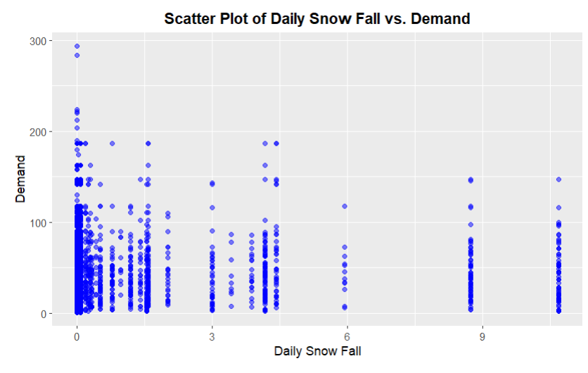
Visualizations using ggplot
This scatter plot shows where increasing levels of snow fall generally lead to lower bike demand.

Slide 10
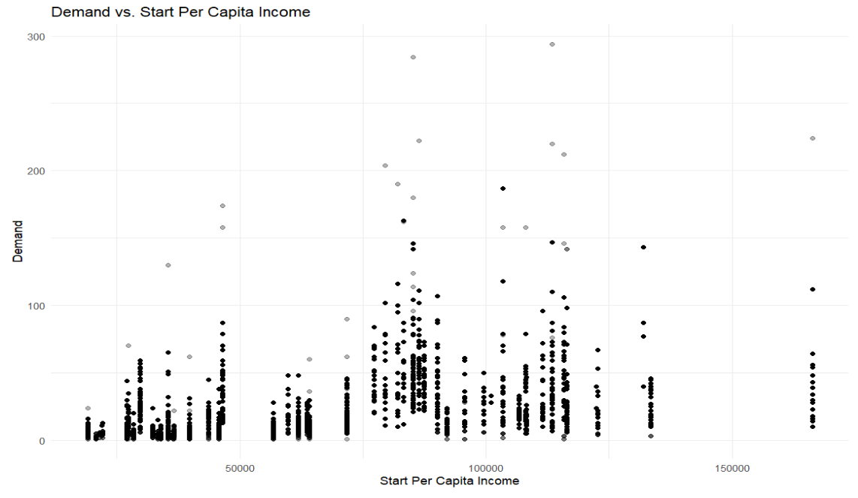
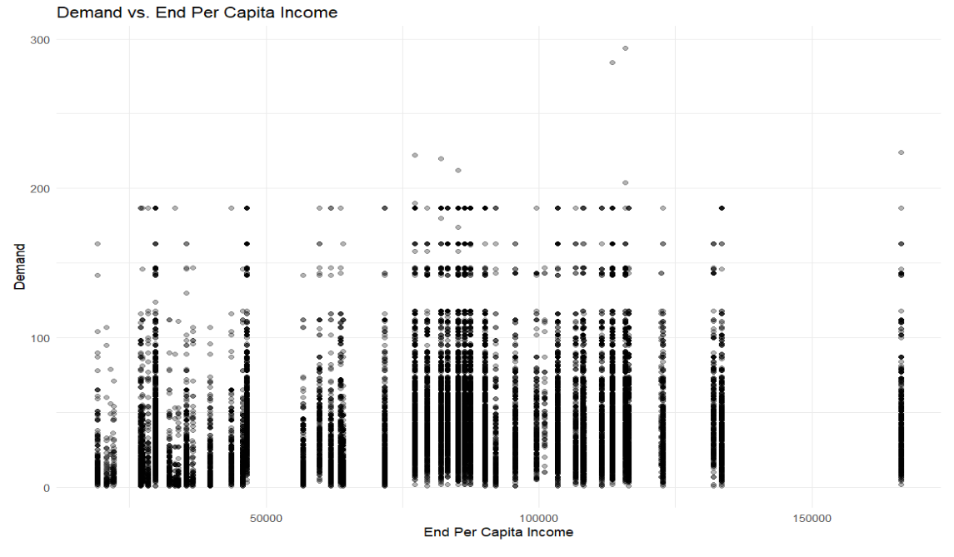
Bivariate Visualizations
These scatterplots could conclude that people are taking these bikes to higher income areas, whether that’s more populated areas or different neighborhoods with different events or offices.

Slide 11
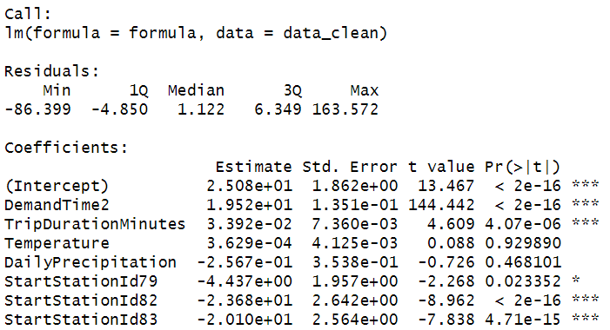
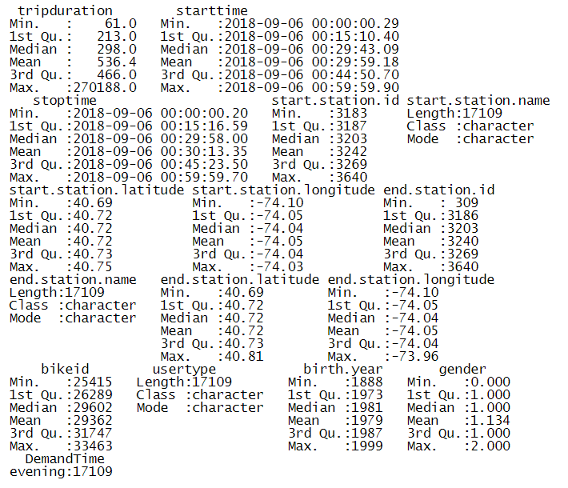
Predictive Analysis: Linear Regression Model
formula <- as.formula("Demand ~ DemandTime + TripDurationMinutes + Temperature + DailyPrecipitation + StartStationId + EndStationId")

Slide 12
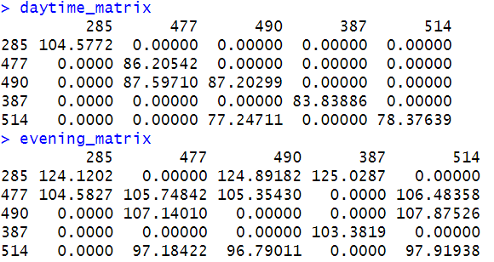
Predictive Analysis: Linear Regression Model

Slide 13
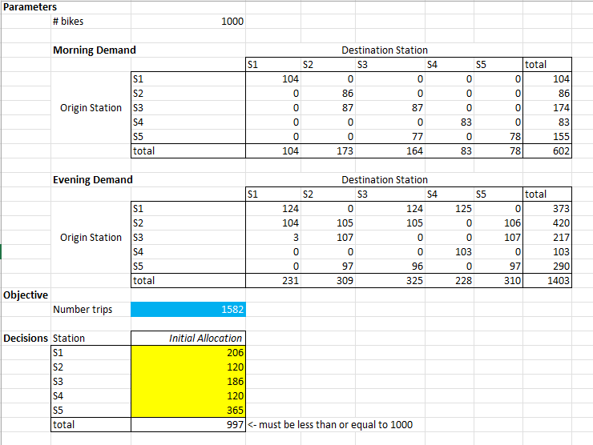
Evidence from Predictive Analysis
Predicted Demands:
Daytime – 602 trips
Evening – 1403 trips
Objective:
Total number of trips: 1582
Bikes allocated: 997

Slide 14
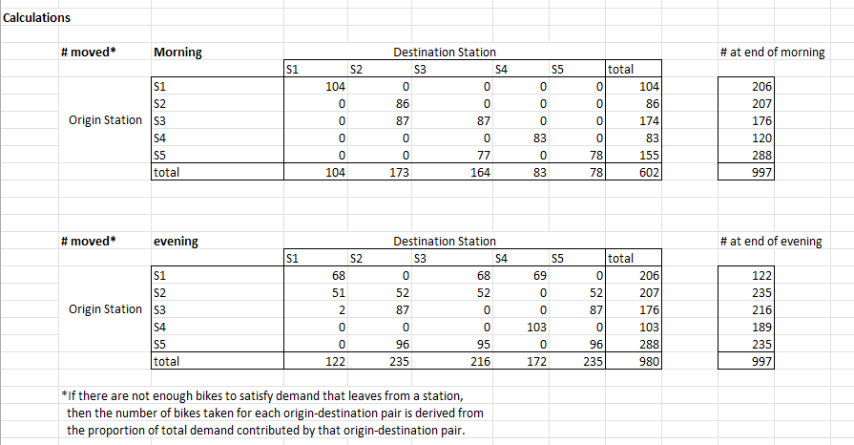
Evidence from Predictive Analysis

Slide 15
Prescriptive Analysis
By looking at the coefficients, factors affecting the demand for bikes are:
DemandTime affects very highly
TripDurationMinutes not more than DemandTime
Temperature not affecting much
DailyPrecipitation not affecting much
Overall, these factors positively affect the Demand.

Slide 16
Proposed Solution and Business Model
Value Proportion
Target Market
Revenue Streams
Efficient, eco-friendly transportation.
Reduced urban traffic congestion.
Equitable bike access across neighborhoods.
Enhanced user experience with better bike availability.
Urban residents and commuters.
Tourists.
Corporations.
City governments.
Membership fees.
Pay-per-use fees.
Corporate partnerships.
Sponsorships and advertising.

Slide 17
Proposed Solution and Business Model
Implementation Strategy
Short-Term Goals
Optimize bike distribution.
Long-Term Goals
Expand service to new areas.
Launch marketing campaigns.
Enhance customer service.
Develop corporate partnerships.
Invest in technology improvements.

